Slide 1
Expliquer l’exhibit de l’article:
Artificial-intelligence-The-time-to-act-is-now?
Exhibit 2
In each industry, artificial-intelligence demand will depend
on market size, pain points, and willingness to pay.

Slide 2
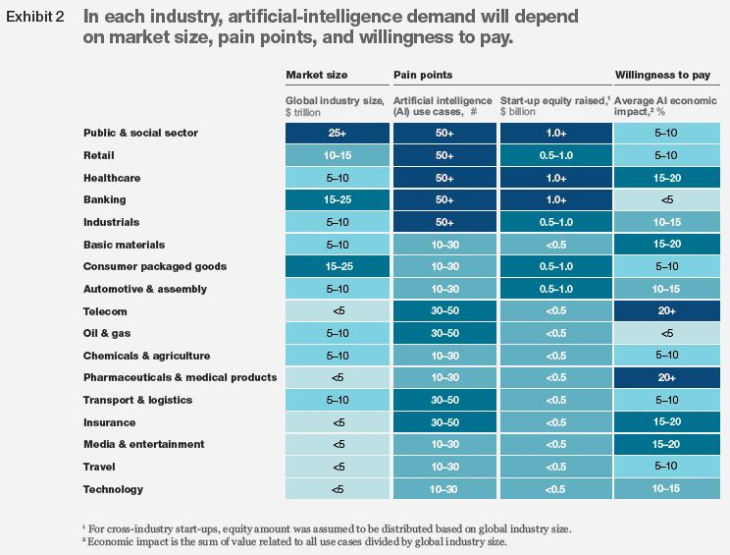

Slide 3
Expliquer l’exhibit de l’article:
Artificial-intelligence-The-time-to-act-is-now?
Exhibit 3
The value at stake from artificial intelligence varies across
industries—and so does the readiness for adoption.

Slide 4
